Slide 1

Introduction to AI (AI101B) AI Language Translation With Sequence Model Session 2024-25
SANGAM KUMAR - 202410116100181
SAQIB MEHDI - 202410116100185
SATYAM GUPTA - 202410116100186
RAM DUBEY- 202410116100160
Project Supervisor:
Ms. Komal Salgotra
ASST. PROFESSOR

Slide 2


AI Language Translation with Sequence Models
Explore how AI translates languages using advanced sequence models. Understand key components and future trends shaping communication worldwide.

Slide 3
What Is a Sequence Model?
Sequence models process data where order matters. They handle inputs like text or speech.
Examples include RNNs, LSTMs, and GRUs. These models remember past inputs.
Used in language, they predict words step-by-step, capturing context.
This helps generate fluent, accurate translations for AI systems.

Slide 4
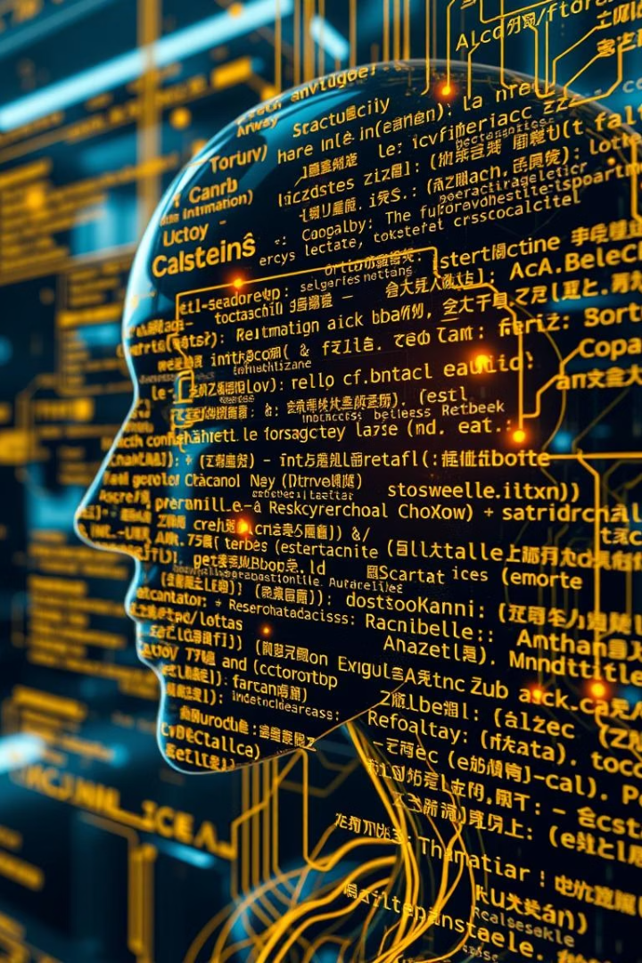
How AI Translates Language
Encode
AI converts input text into numeric vectors representing meaning.
Decode
The model generates output words one at a time, based on context.
Optimize
Training improves accuracy by comparing outputs against correct translations.

Slide 5
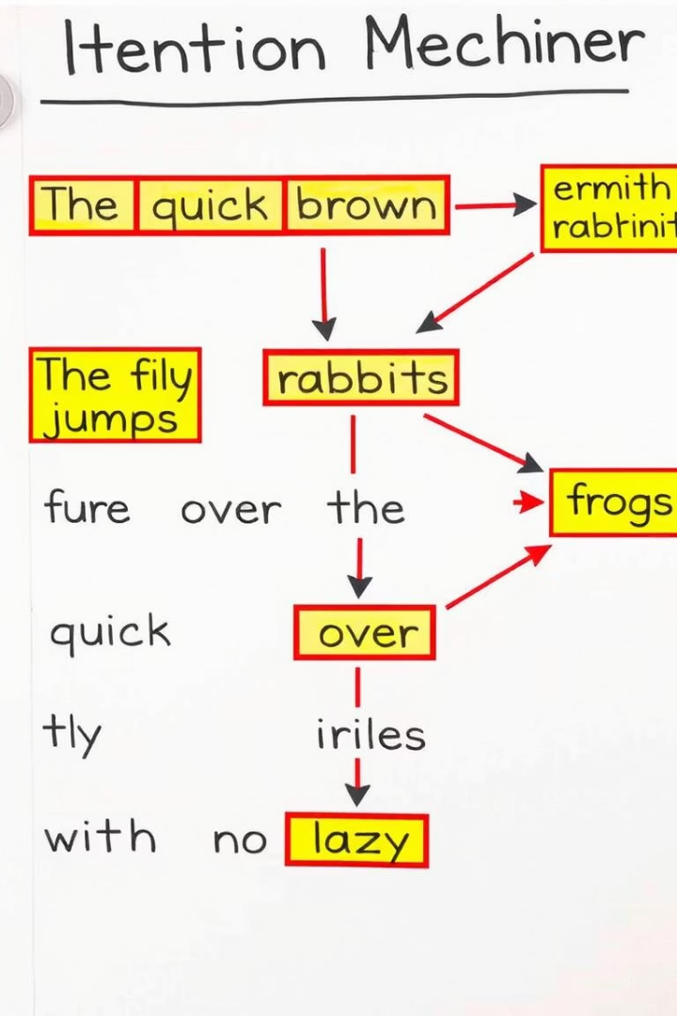
Attention Mechanism
Focuses on Relevant Words
Improves Long Sequence Handling
AI weighs important words dynamically for better context understanding.
Helps retain information from earlier text in lengthy sentences.
Boosts Translation Quality
Allows precise word alignments between source and target languages.

Slide 6

Applications of AI Translation
Real-Time Chat Translation
Bridges language gaps in global conversations instantly.
Document Localization
Fast, accurate translation for diverse industries and markets.
Travel and Tourism
Supports tourists with voice and text translations on the go.
Education and Research
Access to multilingual knowledge and cross-cultural collaboration.

Slide 7





Benefits of AI Translation
Speeds Communication
Instantly bridges language differences worldwide.
Improves Accuracy
Context-aware translations reduce errors.
Increases Accessibility
Makes information available to non-native speakers.
Reduces Cost
Automates translation saving time and money.

Slide 8
Challenges in AI Translation
AI translation faces several key challenges. First, languages have different grammar and word order, which makes direct translation difficult. Second, some words have multiple meanings that depend on context. Third, cultural differences and idioms can be hard to translate correctly. Lastly, AI systems sometimes struggle with long sentences or complicated expressions, leading to mistakes.

Slide 9
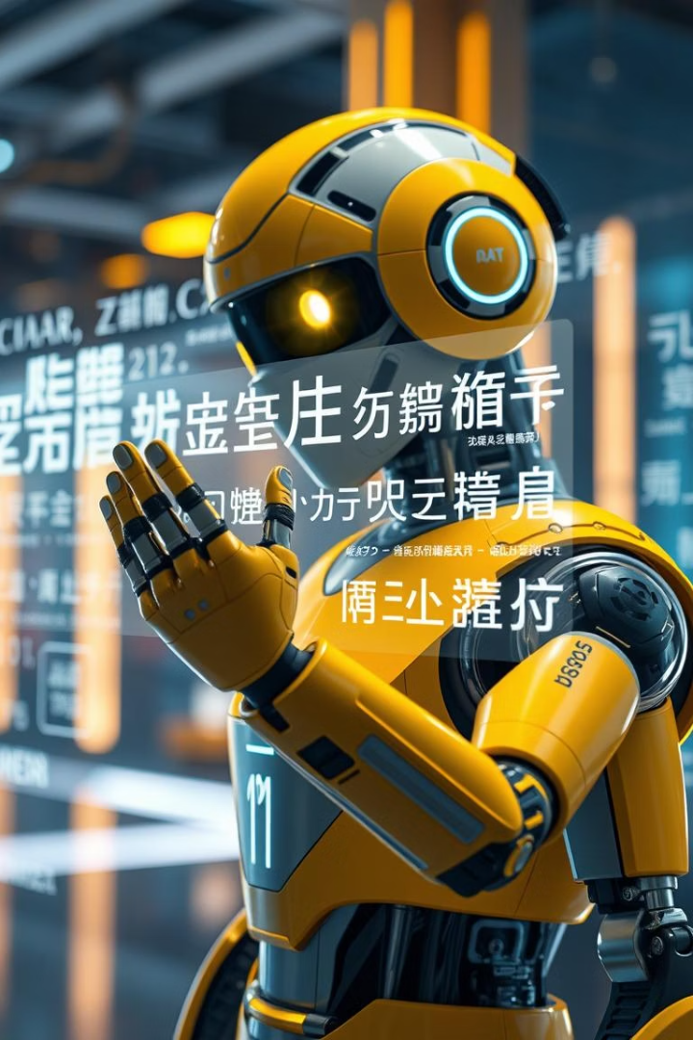
Future of AI Translation
Improved Context Awareness
Models will better understand meaning and intent.
Support for More Languages
Expanding to cover rare and indigenous languages globally.
Multimodal Translation
Combining text, speech, and images for richer results.
Personalized Translation
Adapting style and tone for individual users.

Slide 10

Conclusion
AI sequence models revolutionize language translation globally.
Advances bring accuracy, speed, and accessibility advantages.
Future innovations promise even deeper understanding and inclusion.

Slide 11
THANK YOU

